Slide 1
FILE MANAGEMENT
20PW21 – SAI PRANATHI

Slide 2
What is a Filesystem in OS?
A file system in OS dictates how the contents of a storage medium are stored and organized.
These storage media (such as secondary memory, external drives, etc) could be computer secondary memory.
A filesystem helps in separating the data on the storage into comparatively smaller and simpler segments.
These chunks are files and directories.
The filesystem also provides for storing data related to files, such as their name, extension, permissions, etc.

Slide 3
File Structure in OS
A file is a logical unit of information.
They are produced by processes.
The operating system manages files.
While creating a file, a name is assigned to it. After this process has terminated, the file exists and remains accessible to other processes.
The name of a file has two parts, separated by a dot.
Example, code.cpp is a c++ program file with name code and extension cpp.
The name of the file before the dot is a label for the file's identification, while the part after the dot is called the file extension which indicates the type of the file.

Slide 4
Functions of a File
They are used for storing data in a computer.
They enable the separation of data according to some criteria.
They enable efficient, simple, organized access to data.
They enable locating particular data items in the storage medium.

Slide 5
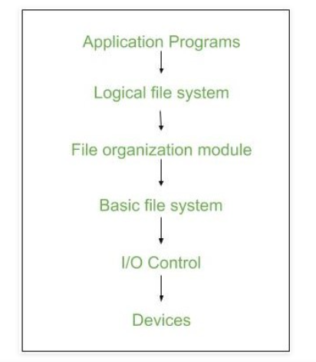
FILE SYSTEM ARCHITECTURE

Slide 6
At the lowest level, device drivers communicate directly with peripheral devices or their controllers or channels.
A device driver is responsible for starting I/O operations on a device and processing the completion of an I/O request.
For file operations, the typical devices controlled are disk and tape drives.
Device drivers are usually considered to be part of the operating system.

Slide 7
I/O Control level –
Device drivers acts as interface between devices and Os,
They help to transfer data between disk and main memory.
It takes block number a input and as output it gives low level hardware specific instruction.
Basic file system
This is the primary interface with the environment outside of the computer system.
It deals with blocks of data that are exchanged with disk or tape systems.
Thus, it is concerned with the placement of those blocks on the secondary storage device and on the buffering of those blocks in main memory.

Slide 8
File organization Module –
It has information about files, location of files and their logical and physical blocks..
Logical I/O
Logical I/O enables users and applications to access records.
Thus, whereas the basic file system deals with blocks of data, the logical I/O module deals with file records.

Slide 9
Advantages :
Duplication of code is minimized.
Each file system can have its own logical file system.
Disadvantages : If we access many files at same time then it results in low performance.

Slide 10
FILE MANAGEMENT SYSTEM
A file management system is set of system software that provides services to users and applications in the use of files
objectives for a file management system:
meet the data management needs and requirements of the user
To optimize performance,
To guarantee that the data in the file are valid
To provide I/O support for a variety of storage device types
To minimize or eliminate the potential for lost or destroyed data
To provide a standardized set of I/O interface routines to user processes
To provide I/O support for multiple users, in the case of multiple-user systems

Slide 11
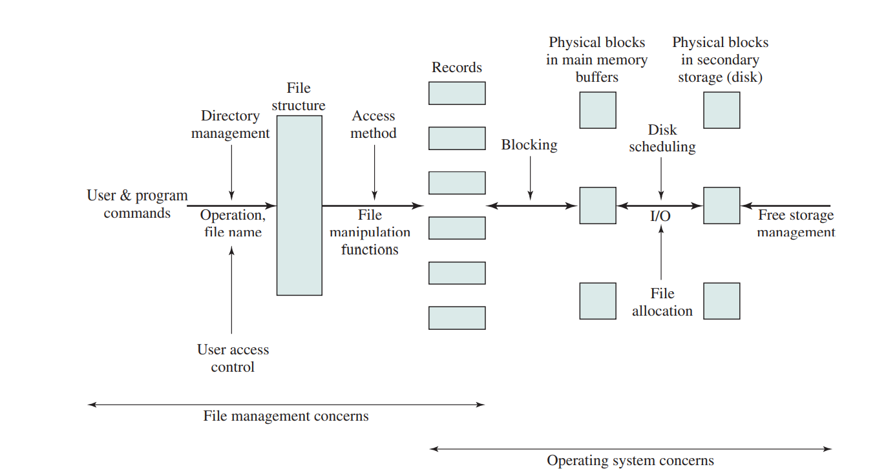
FILE MANAGEMENT FUNCTIONS

Slide 12
users and applications are concerned with records or fields, I/O is done on a block basis.
records or fields of a file must be organized as a sequence of blocks for output and unblocked after input.
The secondary storage must be managed.
Both disk scheduling and file allocation are concerned with optimizing performance.

Slide 13
THANK YOU

